Slide 1
Objects, Classes and Methods
Object-Oriented Programming
3140705
Object-Oriented Programming (01CT0105)
Dr.Chirag Joshi
Department of ICT
chirag.joshi@marwadieducation.edu.in

Slide 2

Looping
What we will learn
Defining classes for objects
Using classes from the java library
Methods

Slide 3
Introduction
Large Data Handling

Slide 4

Class
Class is derived datatype, it combines members of different datatypes into one.
Defines new datatype (primitive ones are not enough).
For Example : Car, College, Bus etc..
This new datatype can be used to create objects.
A class is a template for an object .
Example :
class Car{
String company;
String model;
double price;
double milage;
………
}

Slide 5

Car Class
Class: Car
Properties (Describe)
Company
Model
Color
Mfg. Year
Price
Fuel Type
Mileage
Gear Type
Power Steering
Anti-Lock braking system
Methods (Functions)
Start
Drive
Park
On_break
On_lock
On_turn

Slide 6
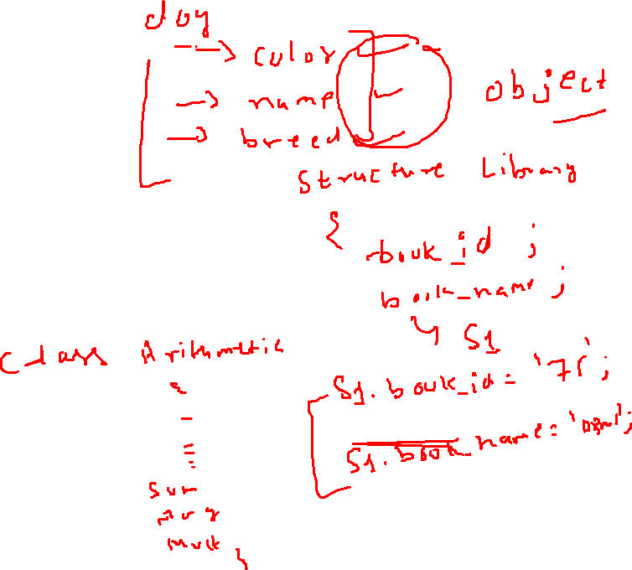
Object
An object is an instance of a class.
An object has a state and behavior.
Example: A dog has
states - color, name, breed as well as
behaviors – barking, eating.
The state of an object is stored in fields (variables), while methods (functions) display the object's behavior.

Slide 7
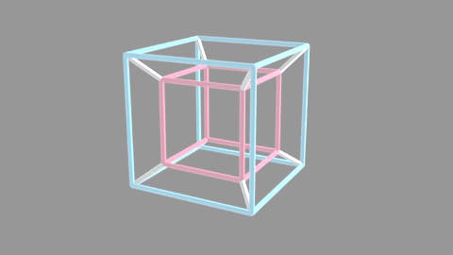
What is an Object?

Slide 8
Philosophy of Object Oriented
Our real world is nothing but classification of objects
E.g. Human, Vehicle, Library, River, Watch, Fan, etc.
Real world is organization of different objects which have their own characteristics, behavior
Characteristic of Human: Gender, Age, Height, Weight, Complexion, etc.
Behavior of Human: Walk, Eat, Work, React, etc.
Characteristic of Library: Books, Members, etc.
Behavior of Library: New Member, Issue Book, Return Book etc.
The OO philosophy suggests that the things manipulated by the program should correspond to things in the real world.
Classification is called a Class in OOP
Real world entity is called an Object in OOP
Characteristic is called Property in OOP
Behavior is called Method in OOP

Slide 9

What is an Object?

Slide 10




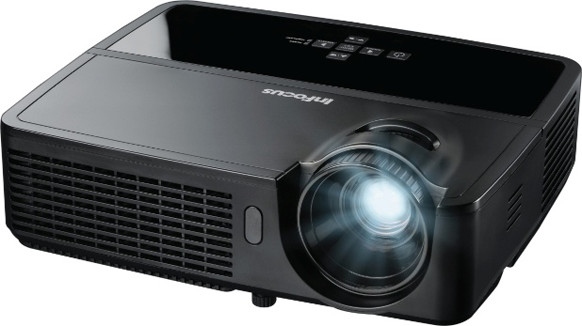

What is an Object?
Pen
Board
Laptop
Bench
Projector
Bike
Physical objects…

Slide 11
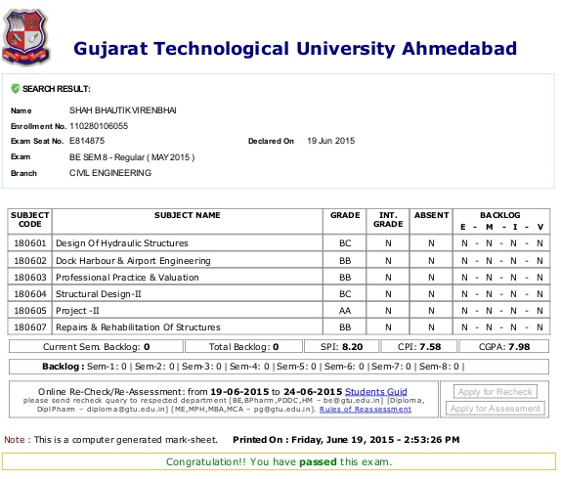

What is an Object? (Cont…)
Result
Bank Account
Logical objects…

Slide 12




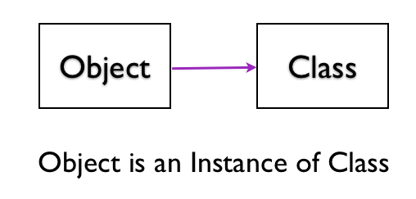

What is an Object?
An Object is a key to understand Object Oriented Technology.
An entity that has state and behavior is known as an object. e.g., Mobile, Car, Door, Laptop etc
Each and every object posses
Identity
State
Behavior
OBJECT

Slide 13

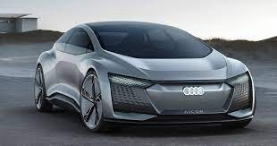

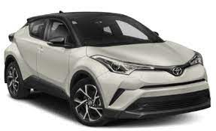


Object: A Real-World Entity
CAR
Class
Object-1 | Object-2 | Object-3 | Object-4 | Object-5

Slide 14

Object: A Real-World Entity
OBJECT: CAR
Events
On_Start
On_Parked
On_Brake
Properties (Describe)
Manufacturer
Model
Color
Year
Price
Methods (Actions)
Start
Drive
Park

Slide 15
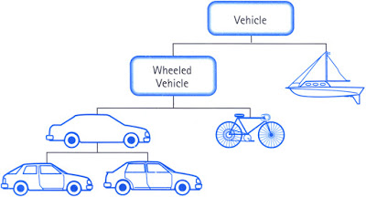
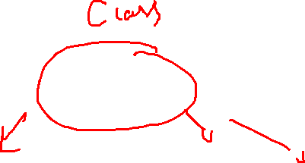
Object: A Real-World Entity

Slide 16
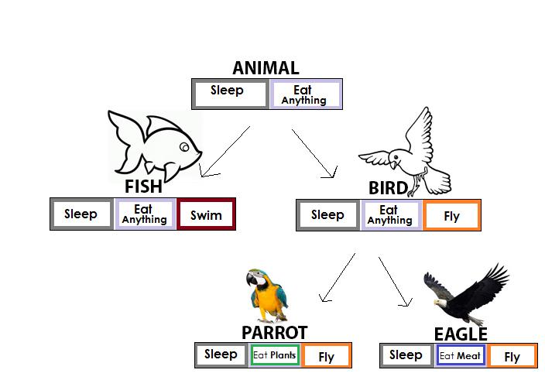
Object: A Real-World Entity

Slide 17





Objects of Class Bird

Slide 18
Classes and Objects

Slide 19
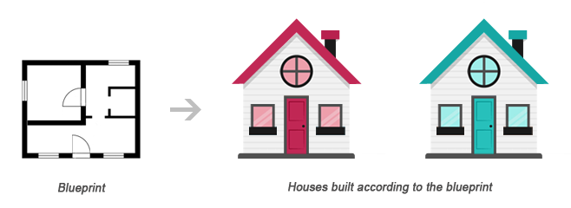
Classes and Objects
Class
Object1
Object2
Class is a blueprint of an object
Object is instance of class
Class describes the object

Slide 20
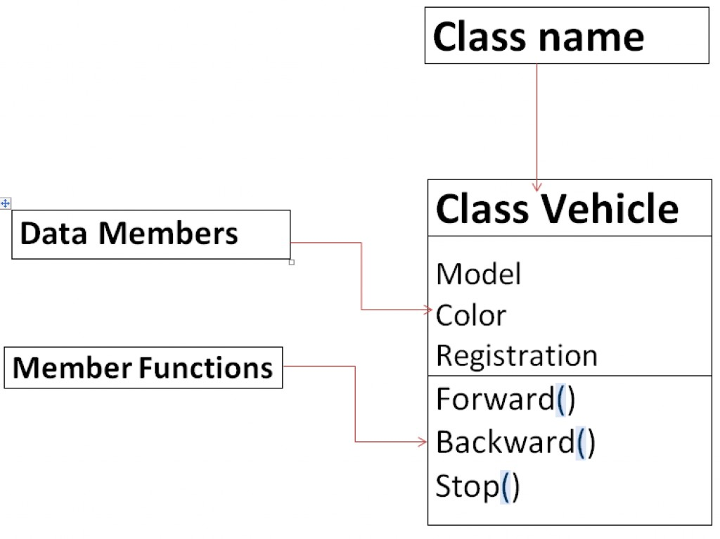
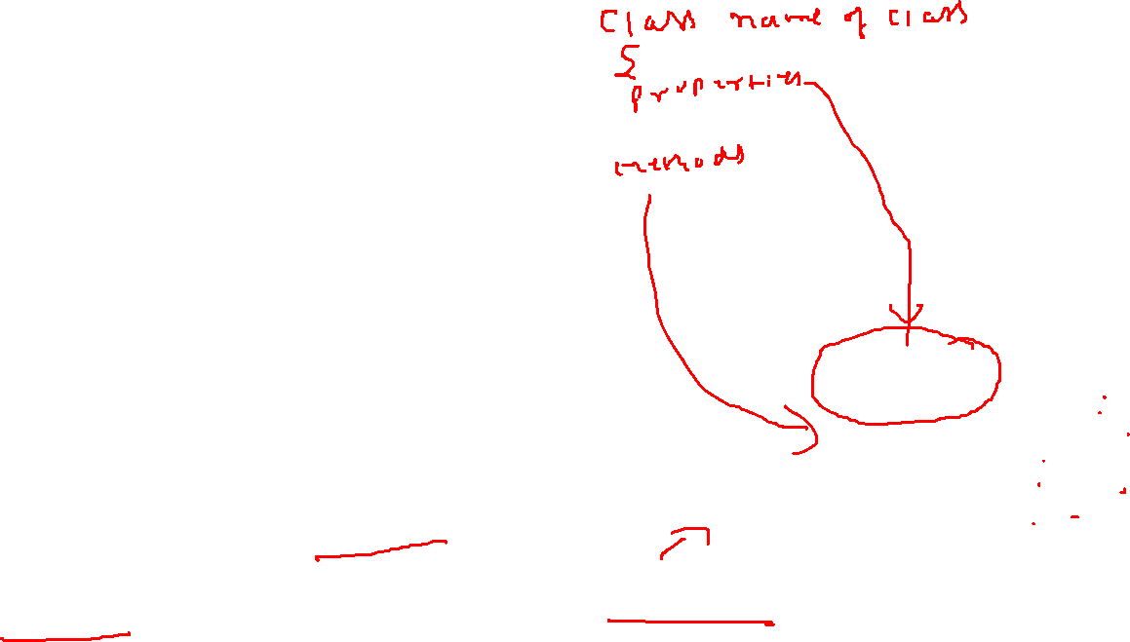
What is Class?
Class can be defined in multiple ways
A class is the building block.
A class is a blueprint for an object.
A class is a user-defined data type.
A class is a collection of objects of the similar kind.
A class is a user-defined data type which combines data and methods.
A class describes both the data and behaviors of objects.
Class contains data members (also known as field or property or data) and member functions (also known as method or action or behavior)
Classes are similar to structures in C.
Class name can be given as per the Identifier Naming Conventions.

Slide 21
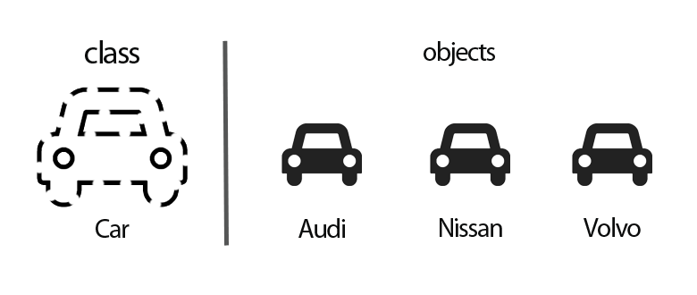

What is Object?
Definition: An Object is an instance of a Class.
An Object is a variable of a specific Class
An Object is a data structure that encapsulates data and functions in a single construct.
Object is a basic run-time entity
Objects are analogous to the real-world entities.

Slide 22
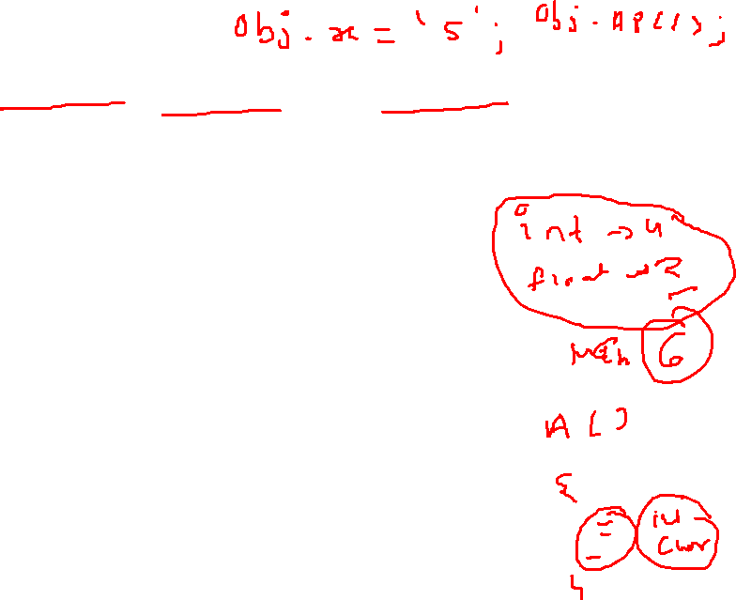
Points to Remember
When a class is defined, only the specification or blueprint for the object is defined; no memory or storage is allocated.
When an object of a class is declared, the memory is allocated as per the data members of a class
We can access the data members and member functions of a class by using a . (dot) operator.
Generally Class contains
Data Members
Member Functions
Constructor (Special Member Function)

Slide 23
Class and Objects
Object 1
Person: P1
Name: Narendra Modi
Gender: Male
Age: 71 Years
Profession: Politician
Class
Person
Person: P1
Name
Gender
Age
Profession
Object 2
Person: P2
Person: P2
Name: Amitabh Bachchan
Gender: Male
Age: 79 Years
Profession: Actor

Slide 24
Class and Objects
Object 1
BankAccount: B1
Account_No: 1001123001
balance: 1,00,000
Class
BankAccount: B1
BankAccount
Object 2
Account_No
balance
BankAccount: B2
BankAccount: B2
Account_No: 1001123002
balance: 5,60,0000
BankAccount: B3
Object 3
BankAccount: B3
Account_No: 1001123003
balance: 10,000

Slide 25
Class and Objects
Object 1
Cube : C1
Name:C1
Height:20cm
Width:20cm
Depth:20cm
Class
Cube : C1
Cube
Object 2
Name
Height
Width
Depth
Cube : C2
Name: C2
Height:5cm
Width:5cm
Depth:5cm
Cube : C2
Cube : C3
Object 3
Cube : C3
Name: C3
Height:10cm
Width:10cm
Depth:10cm

Slide 26
Class and Objects
Person
name
employee of
Company
companyName
Class Diagram
*
*
John:Person
name
employee of
IBM:Company
companyName
Parth:Person
name
Object Diagram
Jaya:Person
name
employee
of
TCS:Company
companyName
Amy:Person
name

Slide 27
Class and Objects
Country
countryName
has
CapitalCity
cityName
Class Diagram
1
1
India:Country
countryName
has
NewDelhi:CapitalCity
cityName
Canada:Country
countryName
has
Ottawa:CapitalCity
cityName
Object Diagram
France:Country
countryName
has
Paris:CapitalCity
cityName
Japan:Country
countryName
has
Tokyo:CapitalCity
cityName

Slide 28
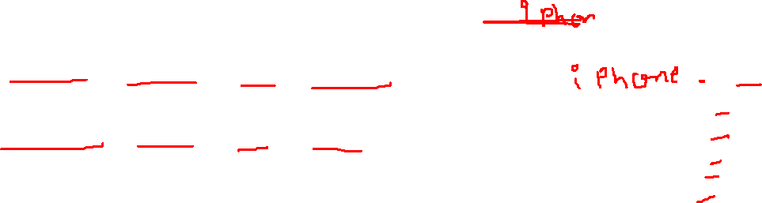
Creating Object & Accessing members
new keyword creates new object
Syntax:
ClassName objName = new ClassName();
Example :
SmartPhone iPhone = new SmartPhone();
Object variables and methods can be accessed using the dot (.) operator
Example:
iPhone.storage = 8000;

Slide 29

Declaring an Object
When we create a class, we are creating a new data type.
Object of that data type will have all the attributes and abilities that are designed in the class
MyProg.java
class Square{
double height;
double width;
}
class MyProg{
public static void main(String[] args) {
}
}
NULL
s1
Square s1;
Square s1=new Square();
height
width
s1
The new operator dynamically allocates (that is, allocates at run time) memory for an object and returns a reference to it.
This reference is, more or less, the address in memory of the object allocated by new.
This reference is then stored in the variable. Thus, in Java, all class objects must be dynamically allocated.

Slide 30
Declaring an Object
MyProg.java
class Square{
double height;
double width;
}
class MyProg{
public static void main(String[] args) {
}
}
An object reference is
similar to a memory pointer.
reference
NULL
s1
Square s1; //declare reference to object
s1= new Square();//allocate a Square object
Allocates
Memory
at Runtime
height
width
new operator dynamically allocates memory for an object
Here, s1 is a variable of the class type.
The class name followed by parentheses specifies the constructor for the class.
It is important to understand that new allocates memory for an object during run time.
s1

Slide 31
Assigning Object Reference
ObjectDemo.java
ObjectDemo.java
Rectangle r1=new Rectangle();
Rectangle r2=r1;
Rectangle r1=new Rectangle();
Rectangle r2=r1;
…
R1=null
r1
Width
Height
r1
Width
Height
r2
Here, r1 and r2 will both refer to the same object. The assignment of r1 to r2 did not allocate any memory or copy any part of the original object. It simply makes r2 refer to the same object as does r1.
r2
Here, r1 has been set to null, but r2 still points to the original object.

Slide 32

WAP using class Person to display name and age
class MyProgram {
public static void main(String[] args) {
Person p1= new Person();
Person p2= new Person();
p1.name="modi";
p1.age=71;
p2.name="bachchan";
p2.age=80;
System.out.println("p1.name="+p1.name);
System.out.println("p2.name="+p2.name);
System.out.println("p1.age="+p1.age);
System.out.println("p2.age="+p2.age);
}//main()
}//class myProgram
class Person
{
String name;
int age;
}//class person
Output
p1.name=modi
p2.name=bachchan
p1.age=71
p2.age=80

Slide 33
WAP using class Person to display name and age with method
class MyProgram {
public static void main(String[] args){
Person p1=new Person();
Person p2=new Person();
p1.name="modi";
p1.age=71;
p2.name="bachchan";
p2.age=80;
p1.displayName();
p2.displayName();
p1.displayAge();
p2.displayAge();
} //main()
} //class myProgram
class Person{
String name;
int age;
public void displayName(){
System.out.println("name="+name);
}
public void displayAge(){
System.out.println("age="+age);
}
}//class person
Output
name=modi
name=bachchan
age=71
age=80

Slide 34
WAP using class Rectangle and calculate area using method
import java.util.*;
class MyProgram {
public static void main(String[] args){
Rectangle r1=new Rectangle();
Scanner sc=new Scanner(System.in);
System.out.print("enter height:");
r1.height=sc.nextFloat();
System.out.print("enter width:");
r1.width=sc.nextFloat();
r1.calArea();
} //main()
}//class myProgram
class Rectangle{
float height;
float width;
public void calArea() {
System.out.println( "Area="+height*width);
} //calArea()
} //class
Output
enter height:30.55
enter width:20.44
Area=624.442

Slide 35
WAP using class Rectangle and calculate area with Return value
import java.util.*;
class MyProgram {
public static void main(String[] args){
float area;
Rectangle r1=new Rectangle();
Scanner sc=new Scanner(System.in);
System.out.print("enter height:");
r1.height=sc.nextFloat();
System.out.print("enter width:");
r1.width=sc.nextFloat();
area=r1.calArea();
System.out.println(“Area="+area);
}//main()
}//class myProgram
class Rectangle{
float height;
float width;
public float calArea() {
return height*width;
}//calArea()
}//class
Output
enter height:30.55
enter width:20.44
Area=624.442

Slide 36
WAP using class Cube and calculate area using method with parameter
import java.util.*;
class MyProgramCube {
public static void main
(String[] args){
float area;
Cube c1= new Cube();
area=c1.calArea(10,10,10);
System.out.println("area="+area);
}//main()
}//class myProgram
class Cube{
float height;
float width;
float depth;
float calArea(float h, float w, float d)
{ height=h;
width=w;
depth=d;
return height*width*depth;
}//calArea()
}//class
10
10
Output
10
area=1000.0

Slide 37
WAP using class Cube and calculate area of two objects
import java.util.*;
class MyProgramCube {
public static void main
(String[] args){
float area;
Cube c1= new Cube(); //Obj1
Cube c2= new Cube(); //Obj2
System.out.println(“c1 area=“ +c1.calArea(10,10,10));
System.out.println(“c2 area=“ +c2.calArea(20,20,20));
} //main()
} //class
class Cube{
float height;
float width;
float depth;
float calArea(float h, float w, float d)
{ height=h;
width=w;
depth=d;
return height*width*depth;
} //calArea()
} //class
20
20
Output
10
10
c1 area=1000.0
c2 area=8000.0
20
10

Slide 38
class Box {
double length;
double breadth;
double height;
}
class BoxDemo {
public static void main(String args[]) {
Box myBox1 = new Box();
Box myBox2 = new Box();
double vol;
myBox1.length = 10;
myBox1.breadth = 20;
myBox1.height = 30;
myBox2.length = 3;
myBox2.breadth = 6;
myBox2.height = 9;
vol = myBox1.length * myBox1.breadth * myBox1.height;
System.out.println("Volume is " + vol);
vol = myBox2.length * myBox2.breadth * myBox2.height;
System.out.println("Volume is " + vol);
}
}
length = 10
length
myBox1
breadth = 20
breadth
height = 30
height
length
length = 3
myBox2
breadth = 6
breadth
height = 9
height

Slide 39
Class vs. Object
Class | Object
Class is a Blueprint or template. | Object is the instance of a class.
Class creates a logical framework that defines the relationship between its members. | When you declare an object of a class, you are creating an instance of that class.
Class is a logical construct. | An object has physical reality. (i.e., an object occupies space in memory.)
Class is a group or collection of similar object. e.g. Car | An Object is defined as real-world entity e.g.:Audi, Volkswagen, Tesla, Ferrari etc.
Class is declared only once | An Object can be created as many times as required
Class doesn’t allocate memory when it is created. | An Object allocates the memory upon creation
Class can exist without its objects. | An Object can’t exist without a class.
Class: Profession Class: Mobile Class: Subject Class: Student Class: Color | Object: Doctor, Teacher, Lawyer, Politician… Object: iPhone, Samsumg, 1plus… Object: Maths, English, Science, Computer… Object: John, Aarav, Smita… Object: Blue, Green, Red, Yellow, Violet, Black…

Slide 40
What is Method?

Slide 41
What is Method?
A method is a group of statements that performs a specific task.
A large program can be divided into the basic building blocks known as method/function.
The function contains the set of programming statements enclosed by { }.
Program execution in many programming language starts from the main function.
main is also a method/function.
void main()
{
// body part
}

Slide 42
Types of Function
Function
Library Function
User Defined Function (UDF)
Predefined or declared inside header files
nextInt() – util library
pow() – math library
Created by User
CalculateSimpleInterest()
CalculateAreaOfCircle()

Slide 43
Program Structure of Function
User-defined function’s program structure is divided into three parts as follows:
C:Function Structure
Java:Function for addition of 2 numbers
void func1();
void main()
{
....
func1();
}
void func1()
{
....
//function body
....
}
Function Prototype
class MethodDemo{
public static void main(String[] ags){
int a=10,b=20,c;
c=add(a,b);
System.out.println("a+b="+c);
}
static int add(int i, int j){
return i+j;
}
}
Function call
Function definition

Slide 44
Method Definition
A method definition defines the method header and body.
A method body part defines method logic.
Method statements
Syntax
Example
return-type method_name(datatyp1 arg1, datatype2 arg2, …)
{
functions statements
}
int addition(int a, int b);
{
return a+b;
}

Slide 45
WAP to add two number using add(int, int) Function
class MethodDemo{
public static void main(String[] args) {
int a=10,b=20,c;
MethodDemo md=new MethodDemo();
c=md.add(a,b);
System.out.println("a+b="+c);
}//main()
int add(int i, int j){
return i+j;
}
}
Output:
a+b=30

Slide 46
Actual parameters v/s Formal parameters
Values that are passed from the calling functions are known actual parameters.
The variables declared in the function prototype or definition are known as formal parameters.
Name of formal parameters can be same or different from actual parameters.
Sequence of parameter is important, not name.
Actual Parameters
Formal Parameters
int a=10,b=20,c;
MethodDemo md=new MethodDemo();
c=md.add(a,b);
// a and b are the actual parameters.
int add(int i, int j)
{
return i+j;
}
// i and j are the formal parameters.

Slide 47
Return Statement
The function can return only one value.
Function cannot return more than one value.
If function is not returning any value then return type should be void.
Actual Parameters
Formal Parameters
int a=10,b=20,c;
MethodDemo md=new MethodDemo();
c=md.sub(a,b);
// a and b are the actual parameters.
int sub(int i, int j)
{
return i – j;
}
// i and j are the formal parameters.

Slide 48
WAP to calculate the Power of a Number using method
import java.util.*;
public class PowerMethDemo1{
public static void main(String[] args){
int num, pow, res;
Scanner sc=new Scanner(System.in);
System.out.print("enter num:");
num=sc.nextInt();
System.out.print("enter pow:");
pow=sc.nextInt();
PowerMethDemo1 pmd=new PowerMethDemo1();
res = pmd.power(num, pow);
System.out.print("ans="+res);
} //main()
int power(int a, int b){
int i, r = 1;
for(i=1; i<=b; i++)
{
r = r * a;
}
return r;
}//power()
}//class
Output:
enter num:5
enter pow:3
ans=125

Slide 49
Types of Methods(Method Categories)
Functions can be divided in 4 categories based on arguments and return value.
Method without arguments and without return value void add();
Method without arguments and with return value int add();
Method with arguments and without return value void add(int, int);
Method with arguments and with return value int add(int, int);

Slide 50
Method without arguments and without return value
main()
{
add();
}
No Arguments
void add()
{
S.O.P(5+10);
}
No Return Value

Slide 51
Method without arguments and with return value
main()
{
int a;
a = add();
}
int add()
{
return 5+10;
}
No Arguments
With Return Value

Slide 52
Method with arguments and without return value
main()
{
int a=5,b=10;
add(a,b);
}
void add(int a, int b)
{
S.O.P(a+b);
}
With Arguments
No Return Value

Slide 53
Method with arguments and with return value
main()
{
int a=5,b=10,c;
c=add(a,b);
}
int add(int a, int b)
{
return a + b;
}
With Arguments
With Return Value

Slide 54
Advantages of Method
Reduced Code Redundancy
Rewriting the same logic or code again and again in a program can be avoided.
Reusability of Code
Same function can be call from multiple times without rewriting code.
Reduction in size of program
Instead of writing many lines, just function need to be called.
Saves Development Time
Instead of changing code multiple times, code in a function need to be changed.
More Traceability of Code
Large program can be easily understood or traced when it is divide into functions.
Easy to Test & Debug
Testing and debugging of code for errors can be done easily in individual function.

Slide 55
Thank You

